Slide 1
Machine Learning CS F464
Dr. Pranav M. Pawar

Slide 2
Contents
Bayesian Learning
Bayes Theorem revisit
Bayes Optimal Classifier
Gibbs Algorithm
Navie Bayes Classifier (Refer to class notes ML_Bayes_Decision Tree)
Bayesian Belief Network

Slide 3
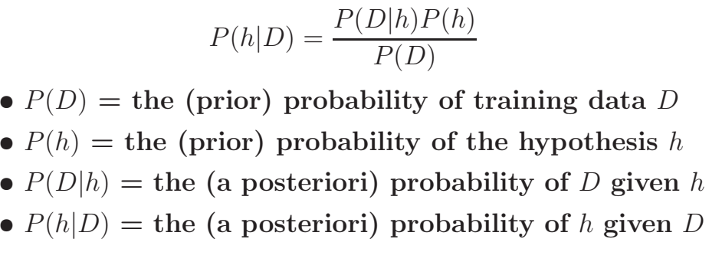
Bayes Theorem

Slide 4
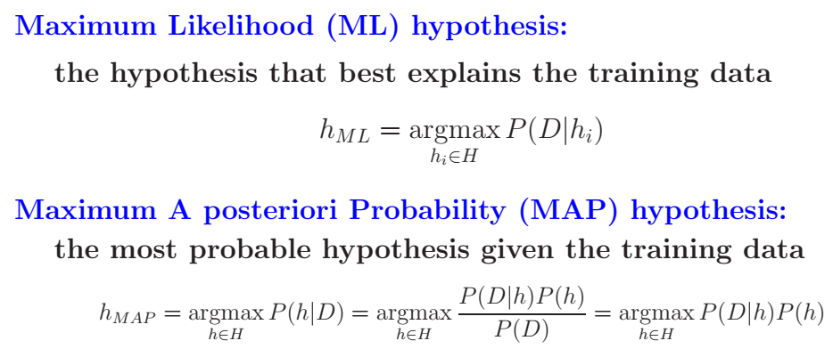
Classes of Hypothesis

Slide 5
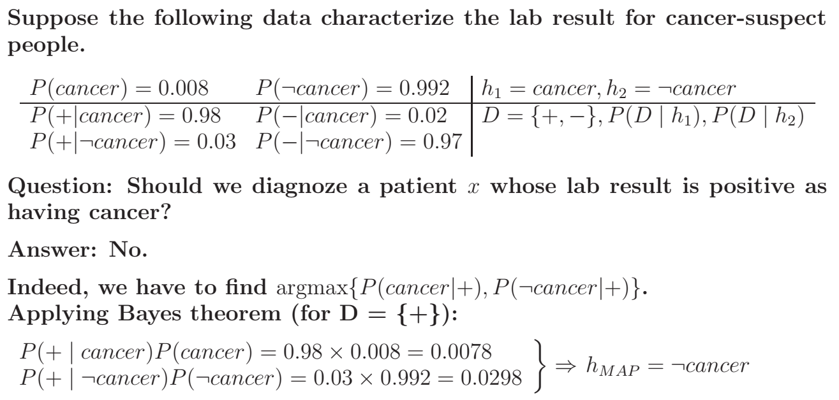
Example (MAP)

Slide 6

Learning using MAP hypothesis
Training: Choose the hypothesis with the highest posterior probability.
Testing: Given x, compute h_{MAP}(x)
Drawback: Requires to compute all probabilities P(D|h) and P(h).

Slide 7


Bayes Optimal Classifier
Given new instance x — the classification of which can take any value v_{j} in some set V —, what is its most probable classification?
Solution is,
Therefore, the Bayes optimal classification of x is,

Slide 8
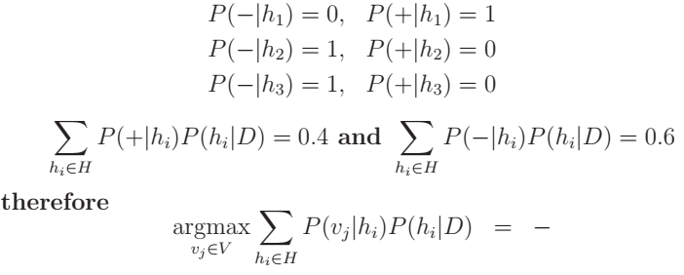
Example (Bayes Optimal Classifier)
Let us consider three possible hypotheses:
In this case,
Let’s consider an instance x such that,
What is the most probable classification of x?

Slide 9
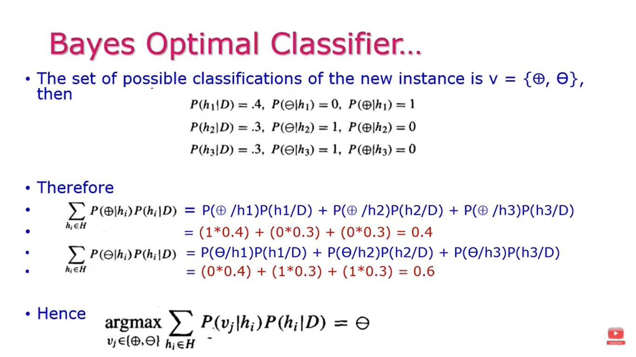
Example (Bayes Optimal Classifier)

Slide 10
Gibbs Algorithm
Bayes Optimal is quite costly to apply. It computes the posterior probabilities for every hypothesis in H and combines the predictions of each hypothesis to classify each new instance.
Gibbs Algorithm
Choose one hypothesis at random, according to P(h|D)
Use this to classify new instance
Under certain conditions (like uniform prior over H) the expected misclassification error for Gibbs algorithm is at most twice the expected error of the Bayes optimal classifier.

Slide 11
Bayesian Belief Network
Bayesian Belief networks describe conditional independence among subsets of variables.
It allows the combination of prior knowledge about (in)dependencies among variables with observed training data.
A Bayesian network specifies a joint distribution in a structured form
A Bayes net (also called a belief network) is an augmented directed acyclic graph, represented by the pair V , E where:
V is a set of vertices.
E is a set of directed edges joining vertices. Edge shows direct dependence. No loops of any length are allowed.
Each vertex in V contains the following information:
The name of a random variable
A probability distribution table indicating how the probability of this variable’s values depends on all possible combinations of parental values.
Two components to a Bayesian network
The graph structure (conditional independence assumptions)
The numerical probabilities (for each variable given its parents)

Slide 12

Conditional Independence
X is conditionally independent of Y given Z if the probability distribution governing X is independent of the value of Y given a value of Z:
More compactly, we write

Slide 13
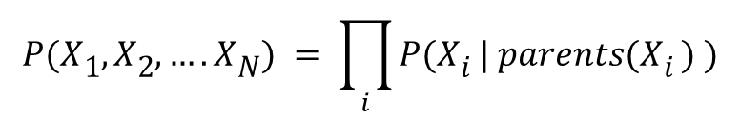

Simple Bayesian net
Directed edges => direct dependence
Absence of an edge => conditional independence
$$P(X1, X2,….XN) = \prod_{i}{P(Xi | parents(Xi ) )}$$
A
B
$$P\left(A,B,C\right)=P\left(C | A,B\right)P\left(A\right)P(B)$$
C
A
B
C
Absolute Independence:
p(A,B,C) = p(A) p(B) p(C)

Slide 14
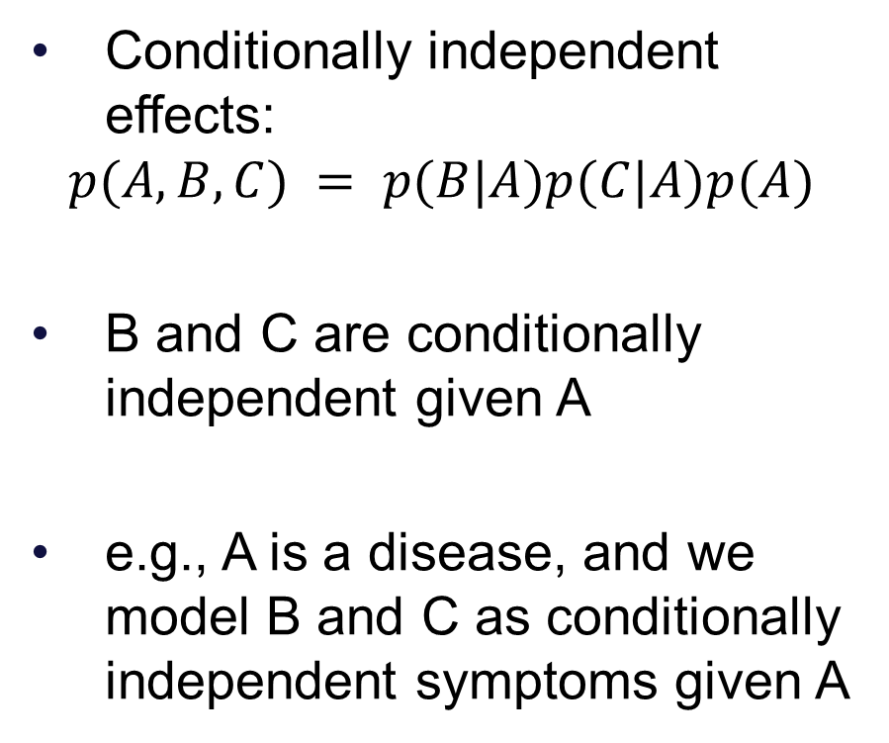
Simple Bayesian net
Conditionally independent effects:
$$p(A,B,C) = p(B|A)p(C|A)p(A)$$
B and C are conditionally independent given A
e.g., A is a disease, and we model B and C as conditionally independent symptoms given A
A
B
C

Slide 15
Example
You have a new burglar alarm installed
It is reliable about detecting burglary, but responds to minor earthquakes
Two neighbors (John, Mary) promise to call you at work when they hear the alarm
John always calls when hears alarm, but confuses alarm with phone ringing (and calls then also)
Mary likes loud music and sometimes misses alarm!
Given evidence about who has and hasn’t called, estimate the probability of a burglary

Slide 16
Example
Represent problem using 5 binary variables:
B = a burglary occurs at your house
E = an earthquake occurs at your house
A = the alarm goes off
J = John calls to report the alarm
M = Mary calls to report the alarm
What is P(B | M, J) ?
We can use the full joint distribution to answer this question
Requires 2⁵ = 32 probabilities
Can we use prior domain knowledge to come up with a Bayesian network that requires fewer probabilities?

Slide 17
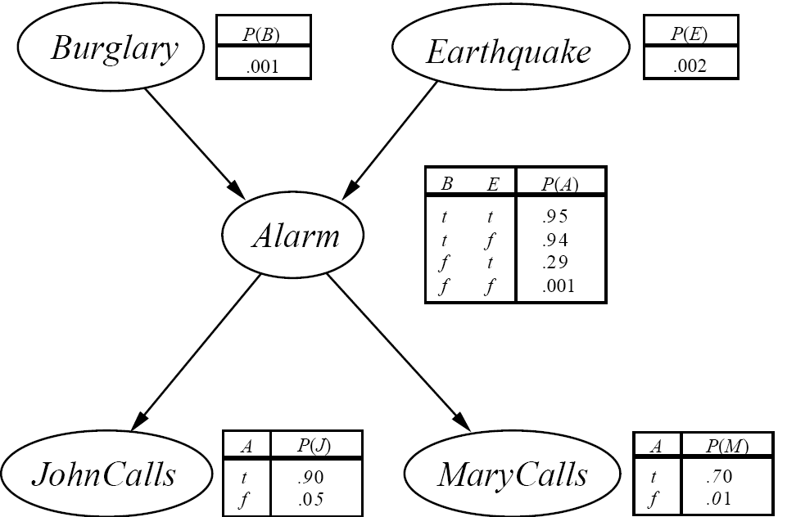
Example
Order the variables in terms of causality (may be a partial order)
e.g., {E, B} -> {A} -> {J, M}
Use these assumptions to create the graph structure of the Bayesian network

Slide 18
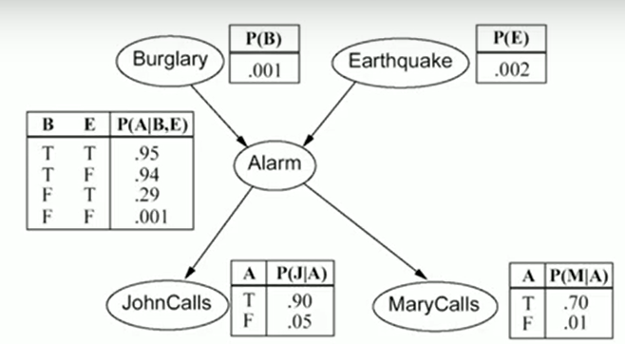

Example
Fill in conditional probability tables (CPTs)
One for each node
$2^{p}$ entries, where $p$ is the number of parents
Where do these probabilities come from?
Expert knowledge
From data
Or a combination of both

Slide 19
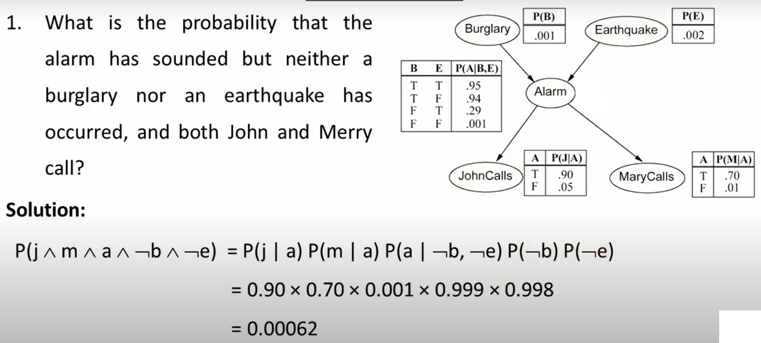
Example

Slide 20
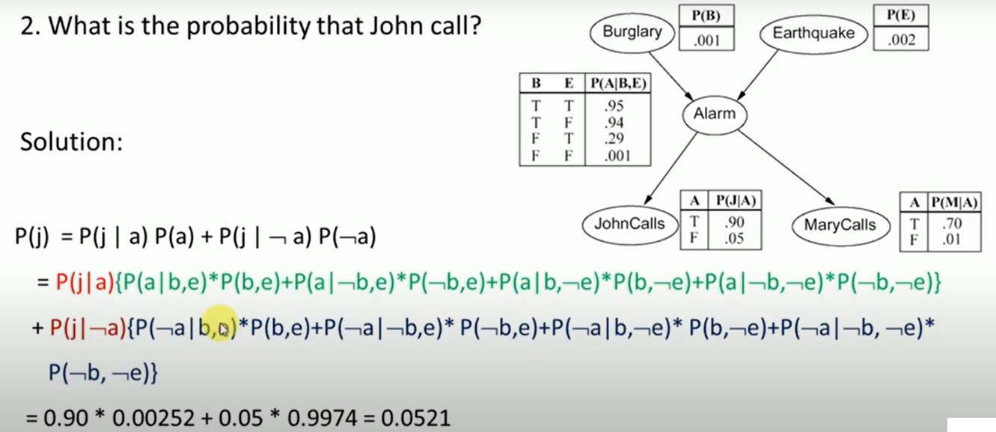
Example

Slide 21
Number of Probabilities in Bayesian Networks
Consider n binary variables
Unconstrained joint distribution requires O(2^{n}) probabilities
If we have a Bayesian network, with a maximum of k parents for any node, then we need O(n 2^{k}) probabilities

Slide 22
Sources
Chapter 6, Tom M. Mitchell, Machine Learning, The McGraw-Hill Companies, 1st edition 2013.
https://www.probabilisticworld.com/bayesian-belief-networks-part-1/
https://www.youtube.com/watch?v=hEZjPZ-Ze0A
https://web.cs.wpi.edu/~dcb/courses/CS4341/2013/Lectures/
https://sites.astro.caltech.edu/~george/aybi199/AMooreTutorials

Slide 23
Thank You!

